Slide 1

Use Imaging to Detect and Count Stainless Steel Flatware in a Tray
Project for CS 585
Imaging and Video Computing
Don Johnson

Slide 2
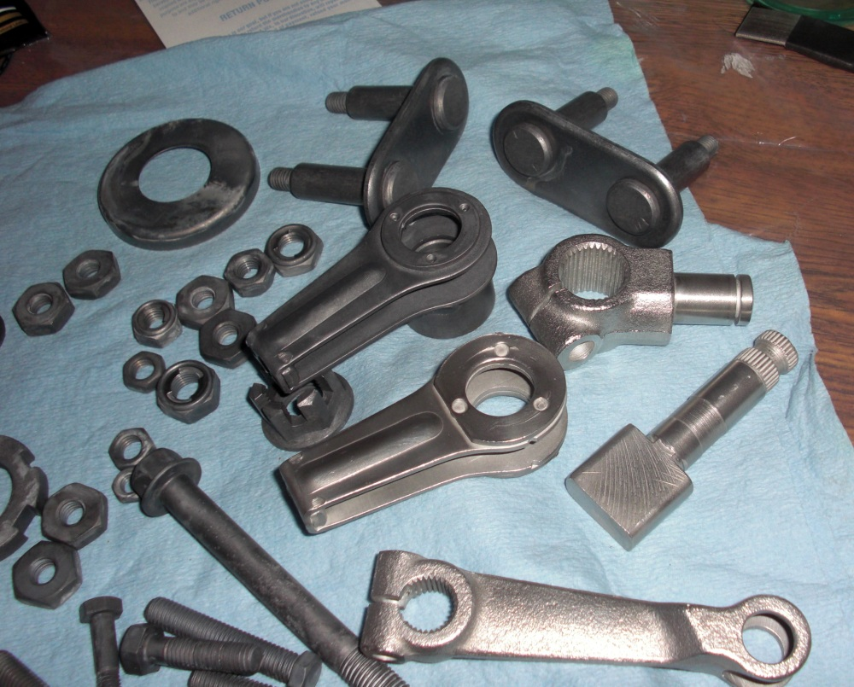
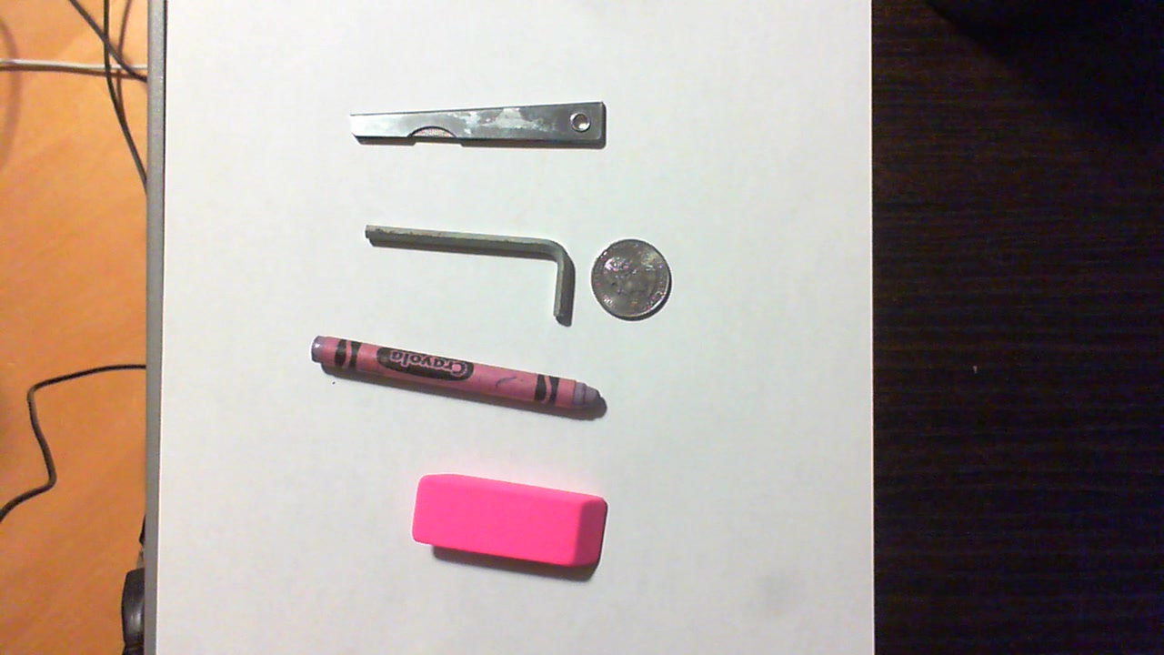
Motivation and Definition of Success
Potential Industrial Applications
Used a modified version of Zdenek Kalal’s OpenTLD system, which failed to count simple items
Would like to create a system that counts metallic items sitting in a tray with the same accuracy that could be achieved by a human
The process of counting the metallic objects should involve minimal human intervention

Slide 3
Data: Source and Attributes
Created homemade rig to hold the camera a fixed distance from a stainless steel tray covered with a surgical huck towel and containing stainless steel flatware
Used by both high-intensity halogen and daylight for illumination
RGB images were taken with a Sony Alpha SLR camera, downsized from the original 3872 x 2592 resolution by a factor of 4

Slide 4
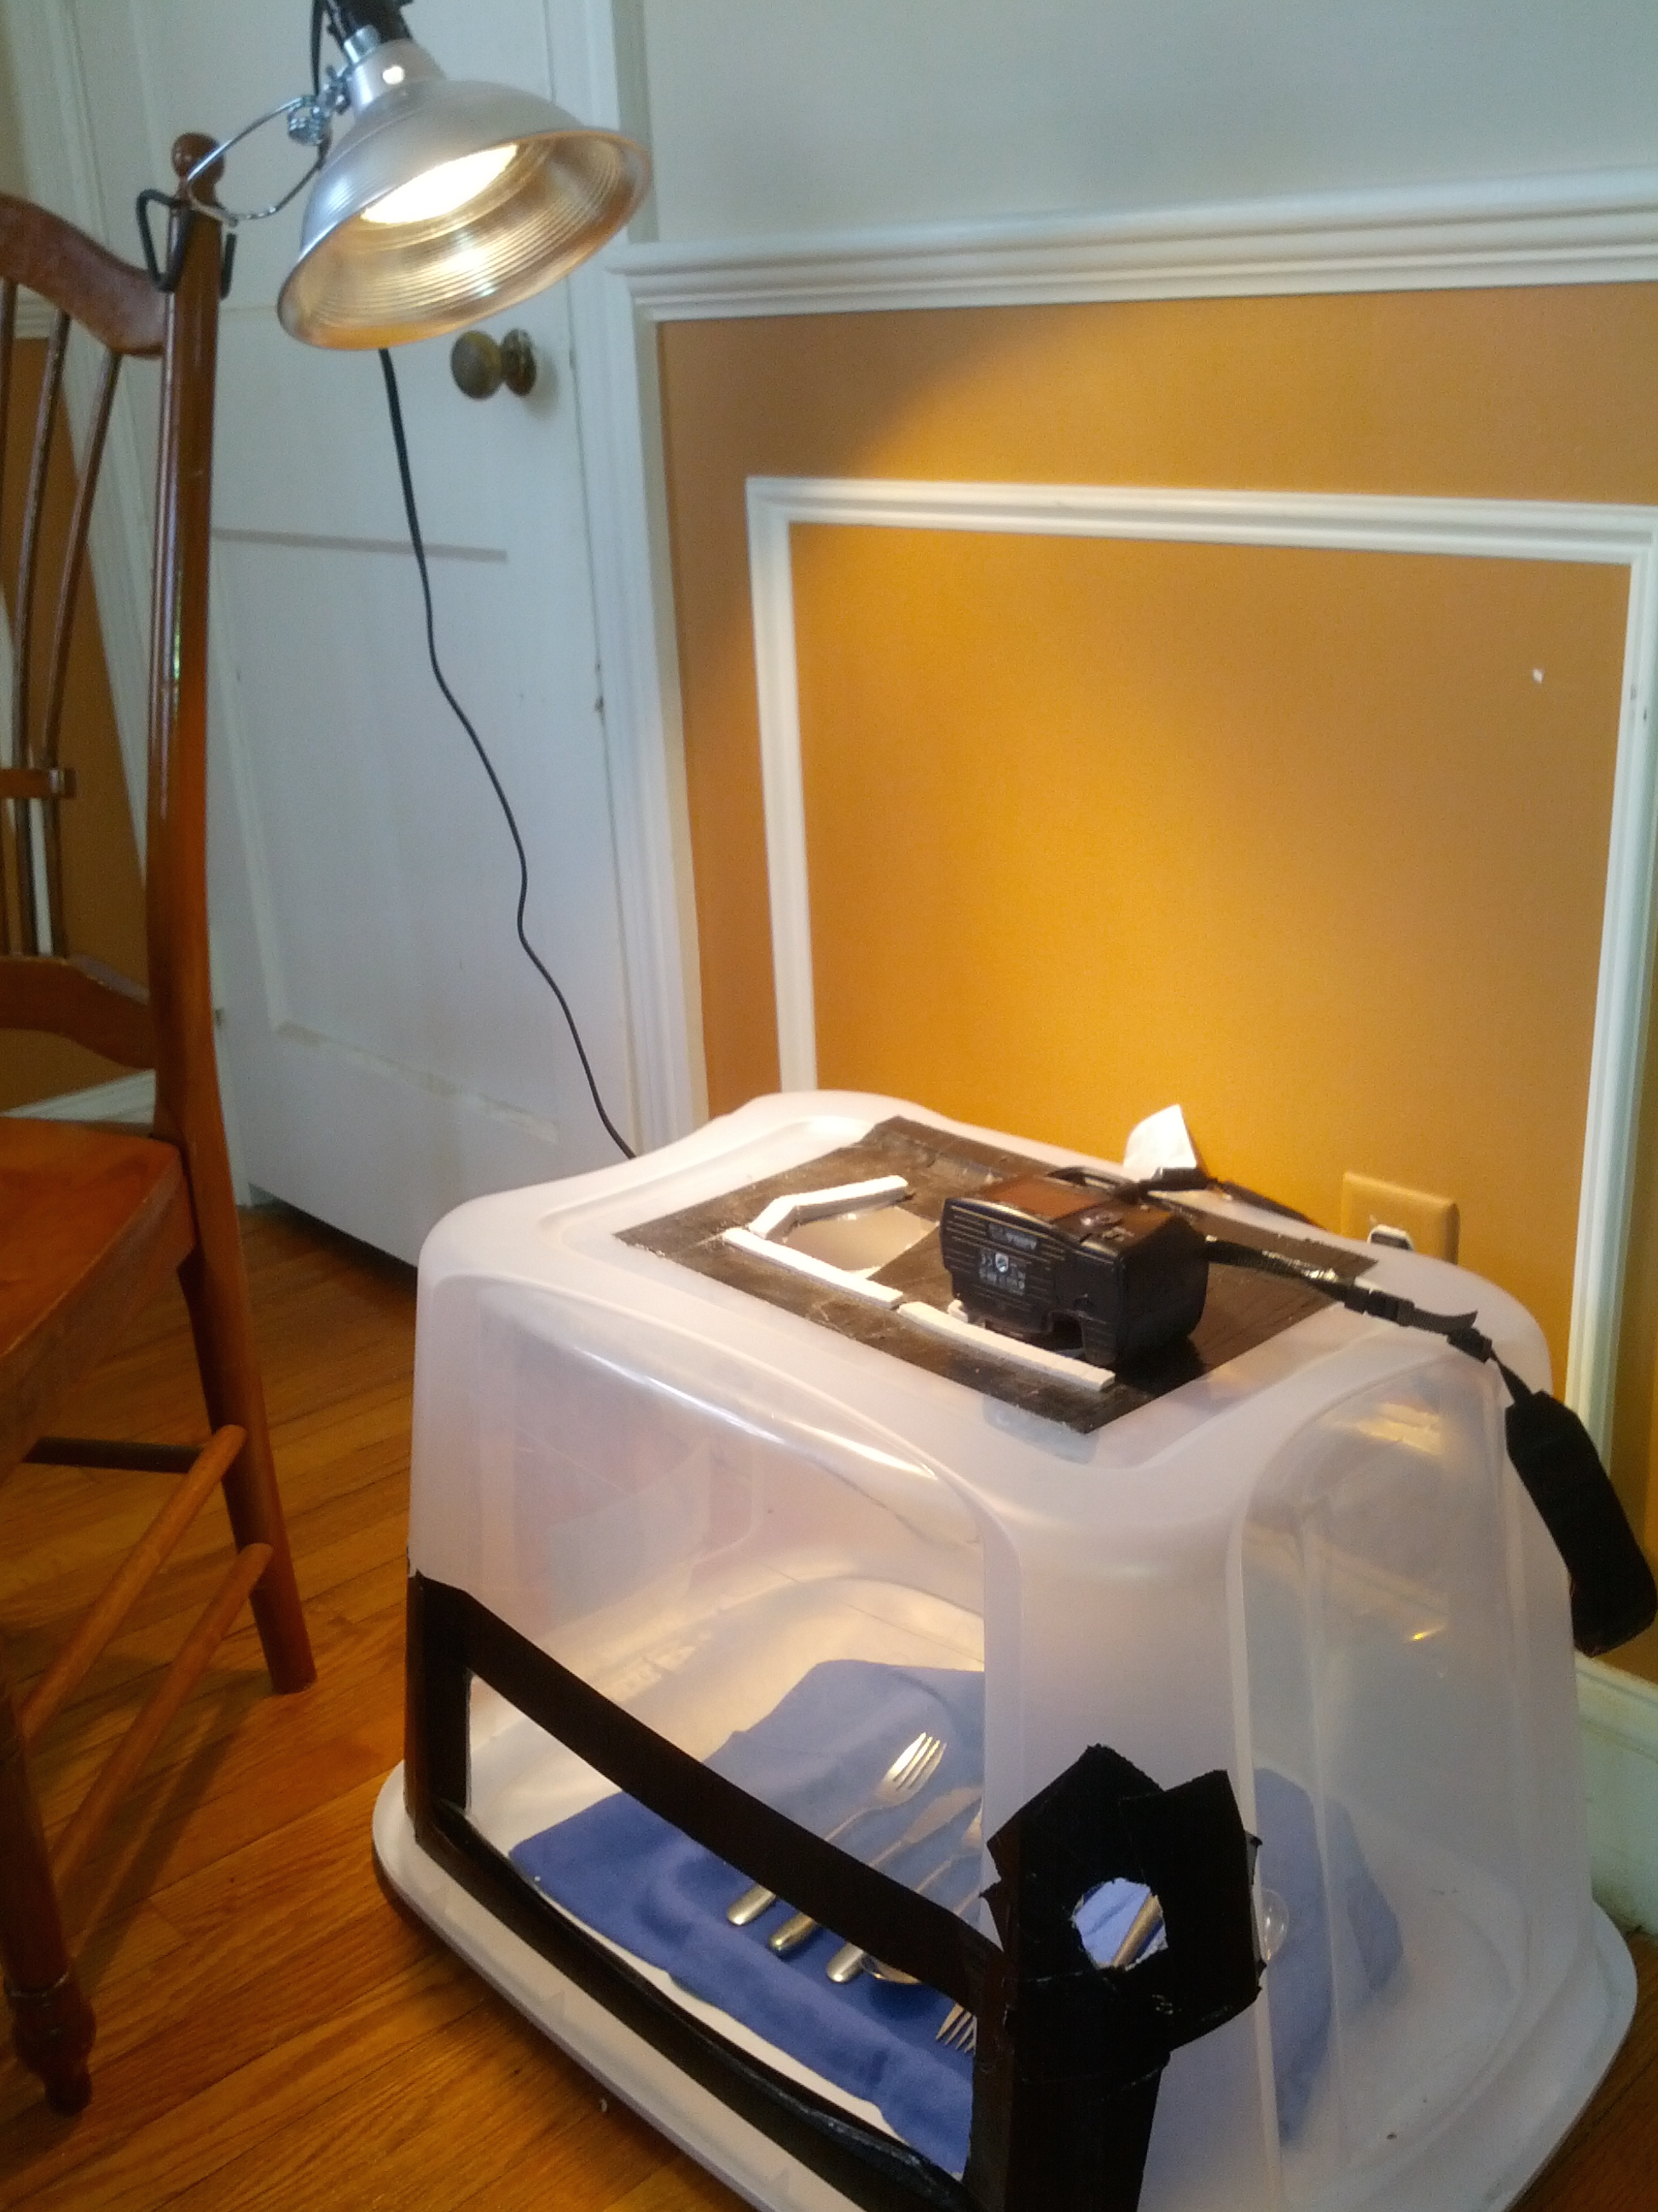
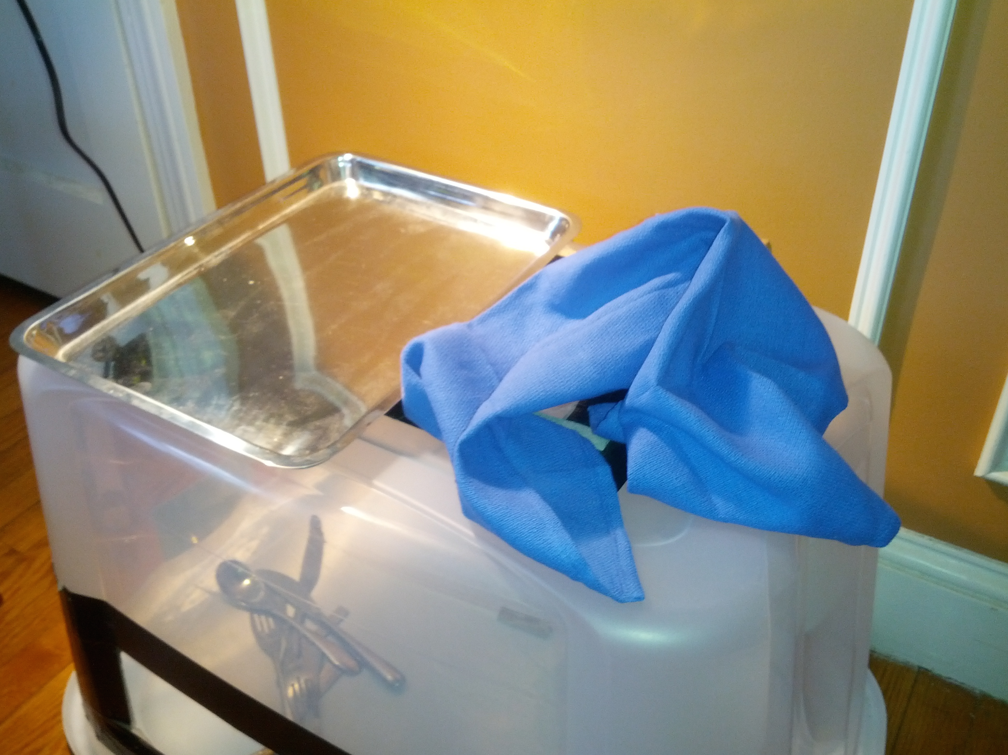
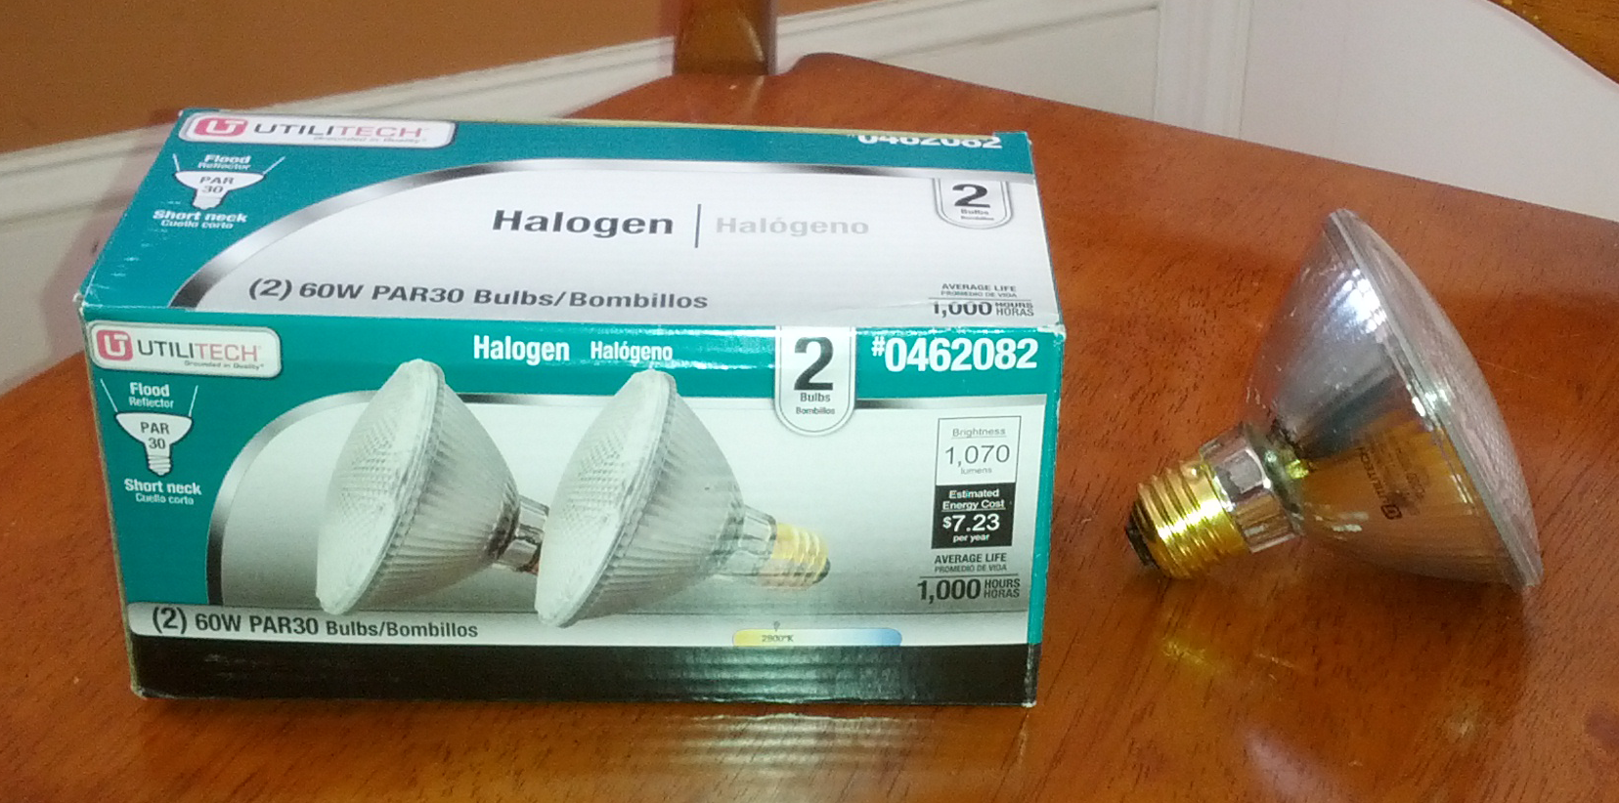
Image Acquisition Rig

Slide 5
Data Acquisition
Image were taken under simulated industrial lighting, and under natural daylight
They taken both with and without a polarizing filter in front of the camera lens
Reflections were a problem, both from objects themselves and from the tray reflecting light through the porous towel

Slide 6
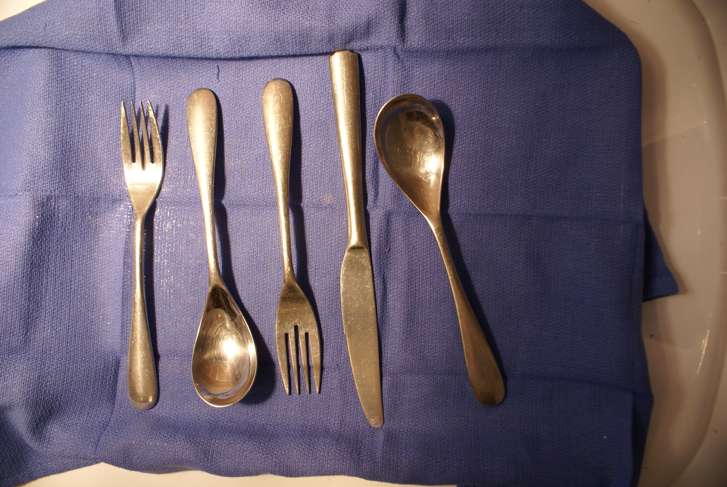
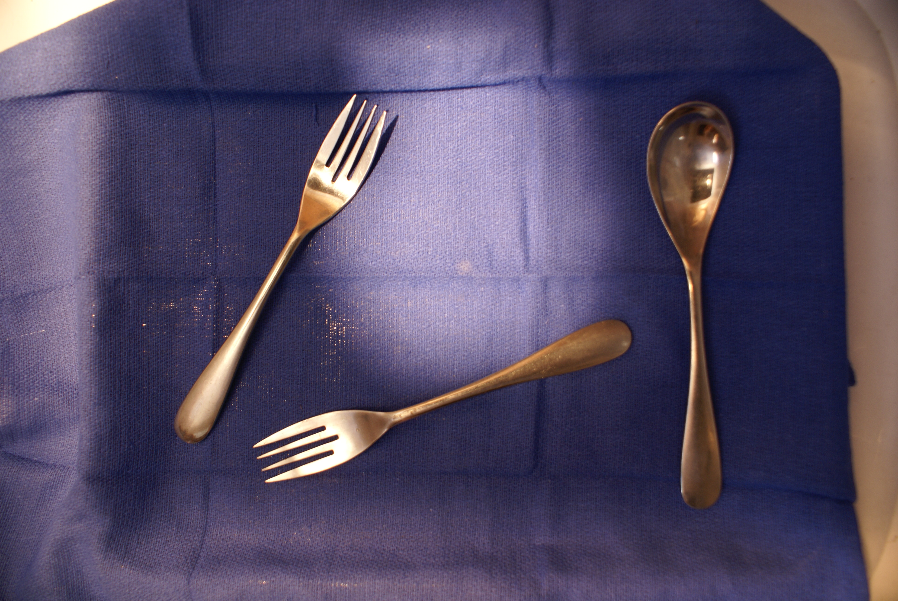
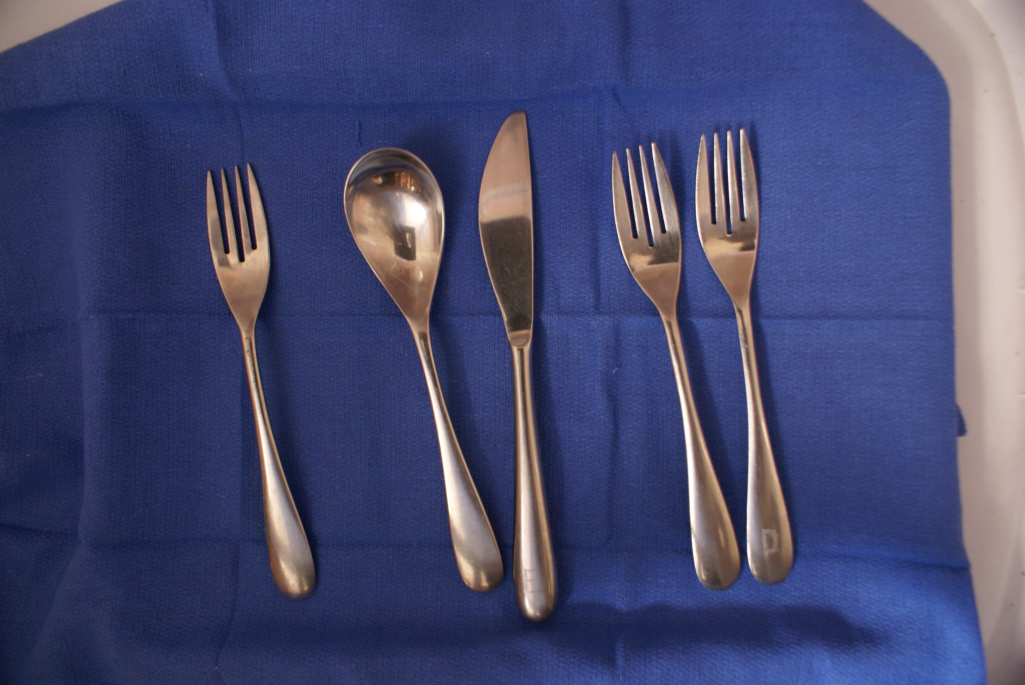
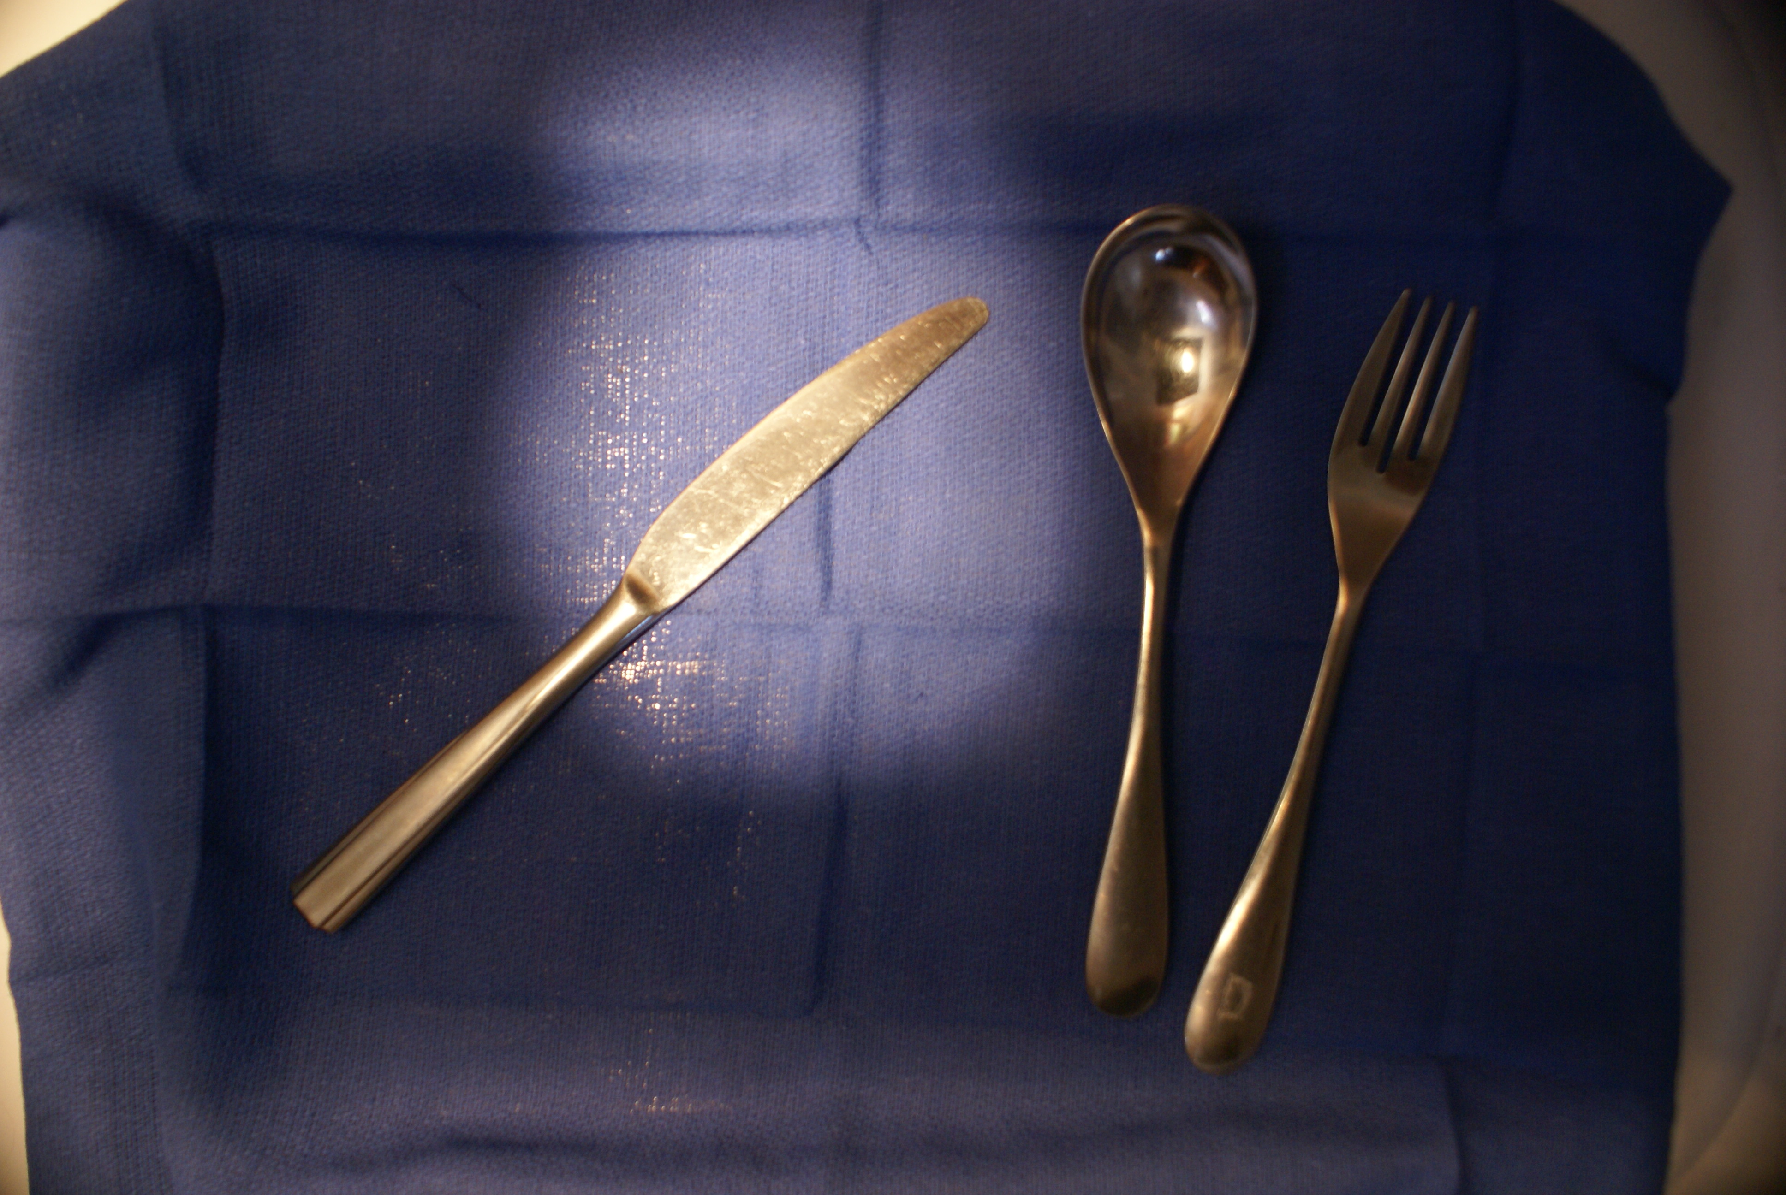
Sample Images

Slide 7
Prior Knowledge
Only had experience working with thermal images and satellite multi-spectral images. Knew nothing about object detection, recognition or tracking
Didn’t realize that OpenTLD wasn’t detecting objects correctly because it was a patch-based detection system and what I needed to being a shape-based detection system (morphological).

Slide 8
Assumptions For This Project
Task would not be too difficult because the objects had simple shapes and I could control camera pose and lighting
Project would not involve object tracking. The object inventories were snapshots in time; objects just needed to be detected and classified
Underestimated the difficulty

Slide 9
Technical Approach: What Didn’t Work
Started with Canny edge detection. The reflections in the flatware created artificial edges. There were also gaps that couldn’t be closed with simple dilation
Canned segmentation, like Fiji’s level-set, active contours plugin. Either flowed over object edges or got stuck at suboptimal background boundaries
Harris-Stephens corner detection either detected false corners, or missed significant corners like the ends of the tines on the forks

Slide 10
Technical Approach: What Worked
1. Change from RGB to YCrCb color space because the value of the green pixel always resides between the two other bands and usually close to the blue.
2. Use k-means clustering to create super-pixels, background vs. object
3. During calibration, Save the k-mean centers, color palette and background pixel class values to be used on subsequent images. The user determines which pixels are background.

Slide 11
Technical Approach: What Worked
5. Run flood fill algorithm to identify and enumerate objects
6. Calculate Hu Invariants, Area and Contour length
7. Classify object using table of known objects with their saved Hu Invariants and compactness values
8. Count the classified objects

